Slide 1
EXPLORING Symbolic Representations of Identity and Collective Behavior in Social Media:
Emoji Use in Twitter
Melanie Swartz
Computational Social Sciences Program
Department of Computational and Data Sciences
Advisor: Andrew Crooks
PhD Dissertation defense, 31 July 2020

Slide 2
Outline
Introduction
History of emojis, current state of research
Research objectives and methodologies
Research questions and results
Conclusion
Limitations and opportunities
Contributions

Slide 3
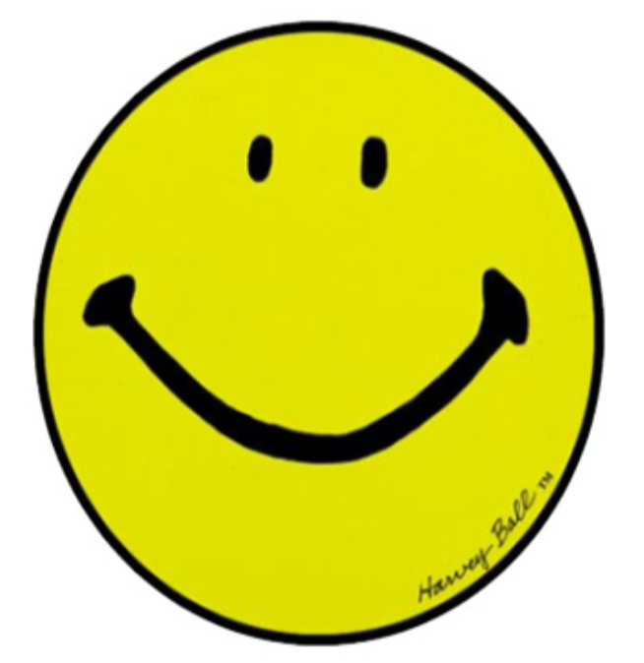
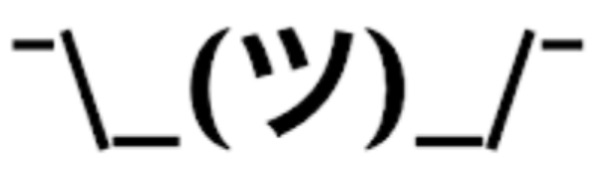
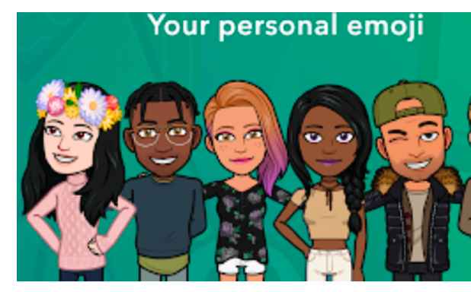

What is an emoji?
:-)
kaomoji
the original smiley
emoticon
sticker
acronym

Slide 4
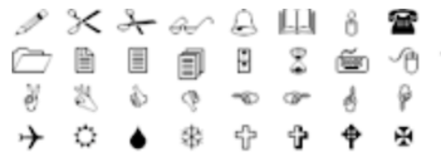

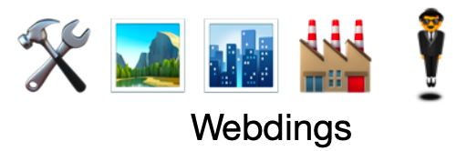
What is an emoji?
☺
glyph
Wingdings
Dingbats

Slide 5
What is an emoji?
😀
emoji

Slide 6
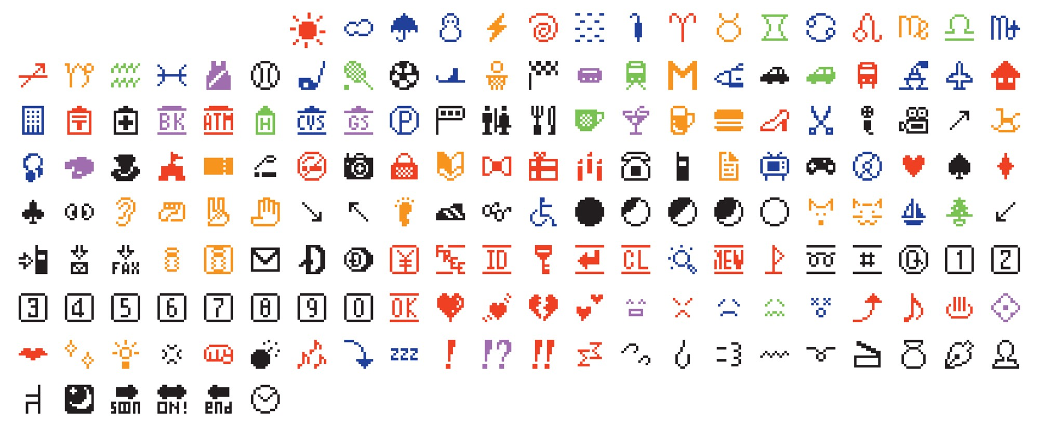
Emoji history
Source: Original color emoji by Shigetaka Kurita from 1999, MOMA 2016.

Slide 7
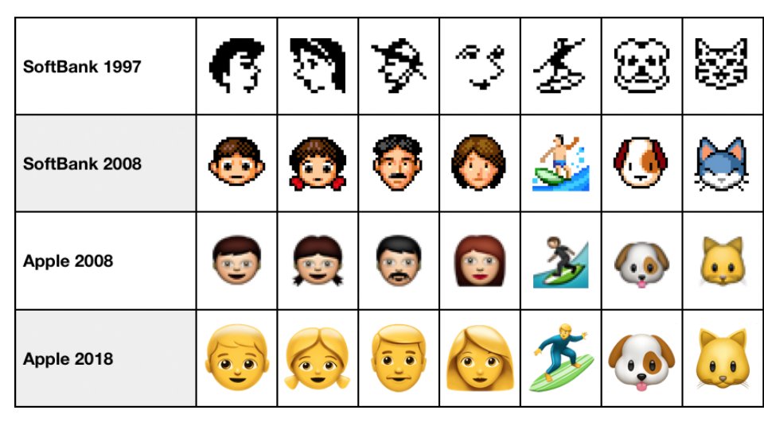
Emoji history
Source: Emojipedia

Slide 8

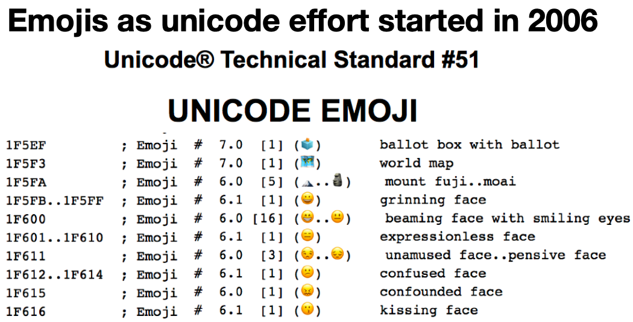
Unicode
Standards
Cross platform support
2010 emoji release

Slide 9
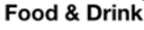
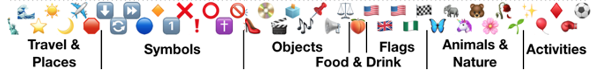
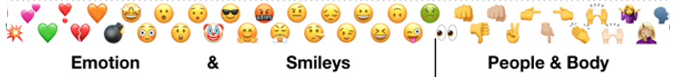
Emojis today
3,304 emojis as of March 2020
10 Unicode Groupings
100 subgroups
🍎 🍋 🍉 🥦 🥨 🥞 🥓 🍔 🍕 🍜 🍥 🧁 🍰 🍩
🍷 ☕️ 🍺 🍻 🍹 🥃 🥂 🥛 🍼 🥤 🍸 🍯 🍫
Components
https://unicode.org/emoji/charts/full-emoji-list.html

Slide 10
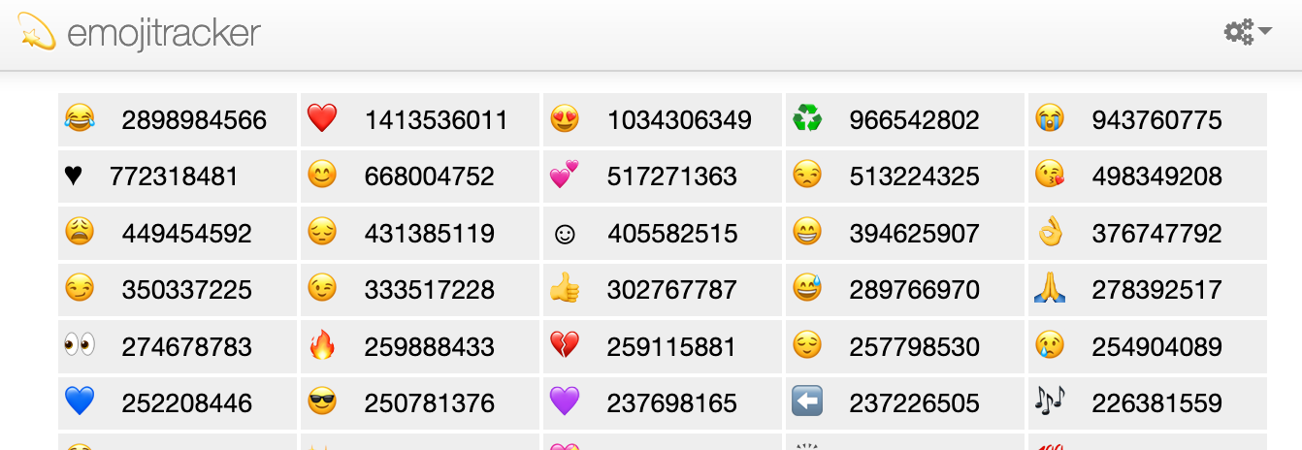
Most popular emojis
Top most used emojis in tweets, July 2020.
Source: https://www.emojitracker.com

Slide 11

Which supervillain do you want to be?

Slide 12
Which supervillain do you want to be?
…. depends on your device or social media platform.

Slide 13
Which supervillain you are …..
Apple
Google
Facebook
Windows
Twitter
JoyPixel
Samsung
…. depends on your device or social media platform.
supervillain emoji Codepoint: U+1F9B9

Slide 14
Current state of emoji research
Meaning and Disambiguation

Slide 15
Current state of emoji research
Meaning and Disambiguation
Sentiment and Faces

Slide 16
Current state of emoji research
Meaning and Disambiguation
Sentiment and Faces
Differences in Which Emojis are Used

Slide 17
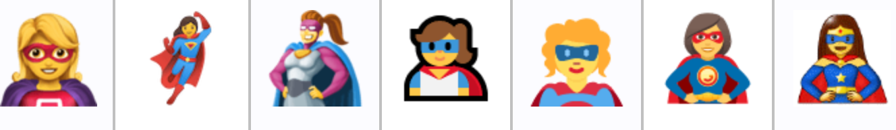
Current state of emoji research
Emoji appearance (Miller et al., 2016)
Nearby text (Tigwell & Flatla, 2016 )
Meaning and Disambiguation
supervillain
woman superhero
supervillain and woman superhero source: Unicode emoji charts
difference in hair color by device

Slide 18
Current state of emoji research
Sentiment and Faces

Slide 19
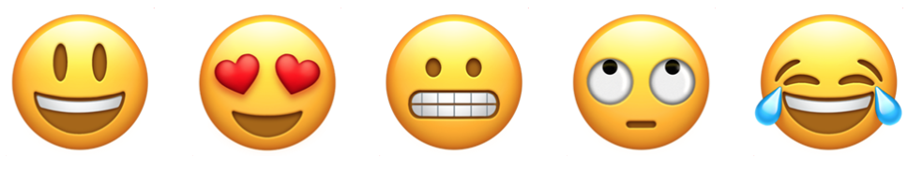
Current state of emoji research
Sentiment, sarcasm, emotion
(Novak et al., 2015; Felbo et al., 2017)
Face gestures
(Gawne & McCullough 2019)
Sentiment and Faces

Slide 20
Current state of emoji research
Differences in Which Emojis are Used

Slide 21
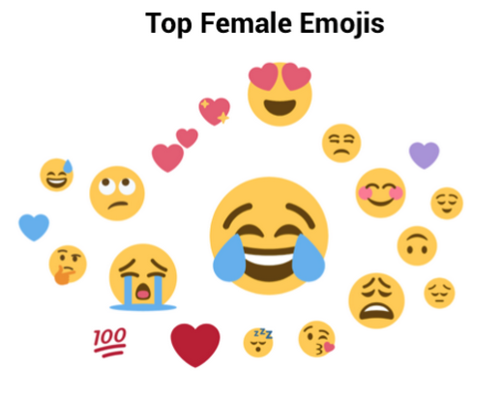
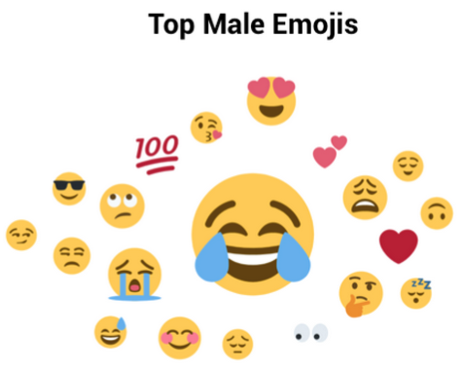
Current state of emoji research
Country Level
(Ljubešić and Fišer 2016)
Skintone
(Barbieri & Camacho-Collados, 2018)
Gender and Age
(Chen et al., 2017; Herring & Dainas, 2018; Na’aman et al., 2017; Twitter report on emojis, 2017)
✊✊🏻✊🏼✊🏽✊🏾✊🏿
Differences in Which Emojis are Used

Slide 22
There’s something missing from emoji research

Slide 23
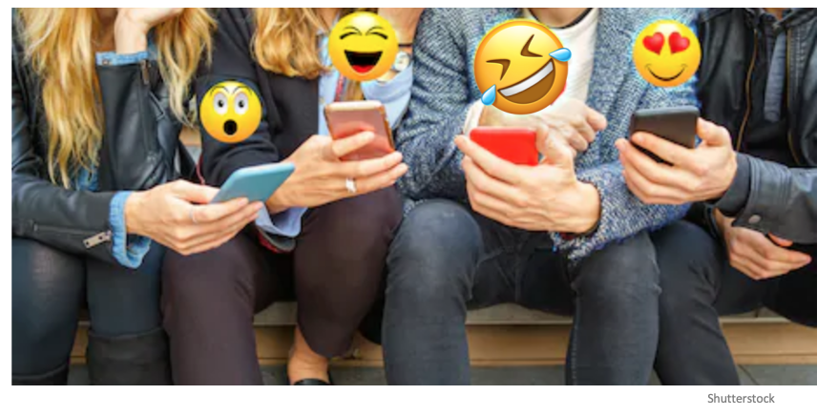
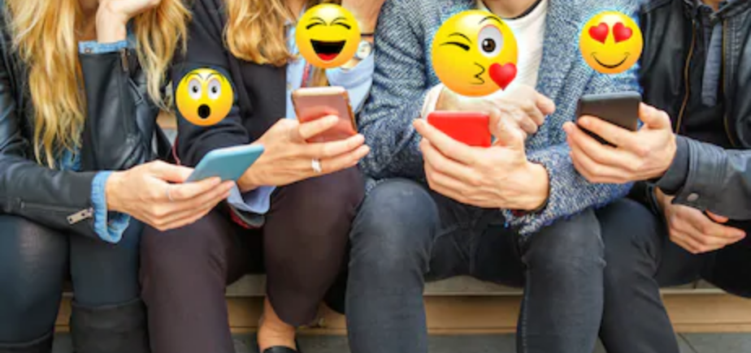
There’s something missing from emoji research
🤣
Shutterstock

Slide 24
There’s something missing from emoji research
… the behavior of emoji use

Slide 25
in social media
🏳️‍🌈
👇🏼
🔴
🤦🏽‍♀️
✝️
😂
❤️
🗳
🌊

Slide 26
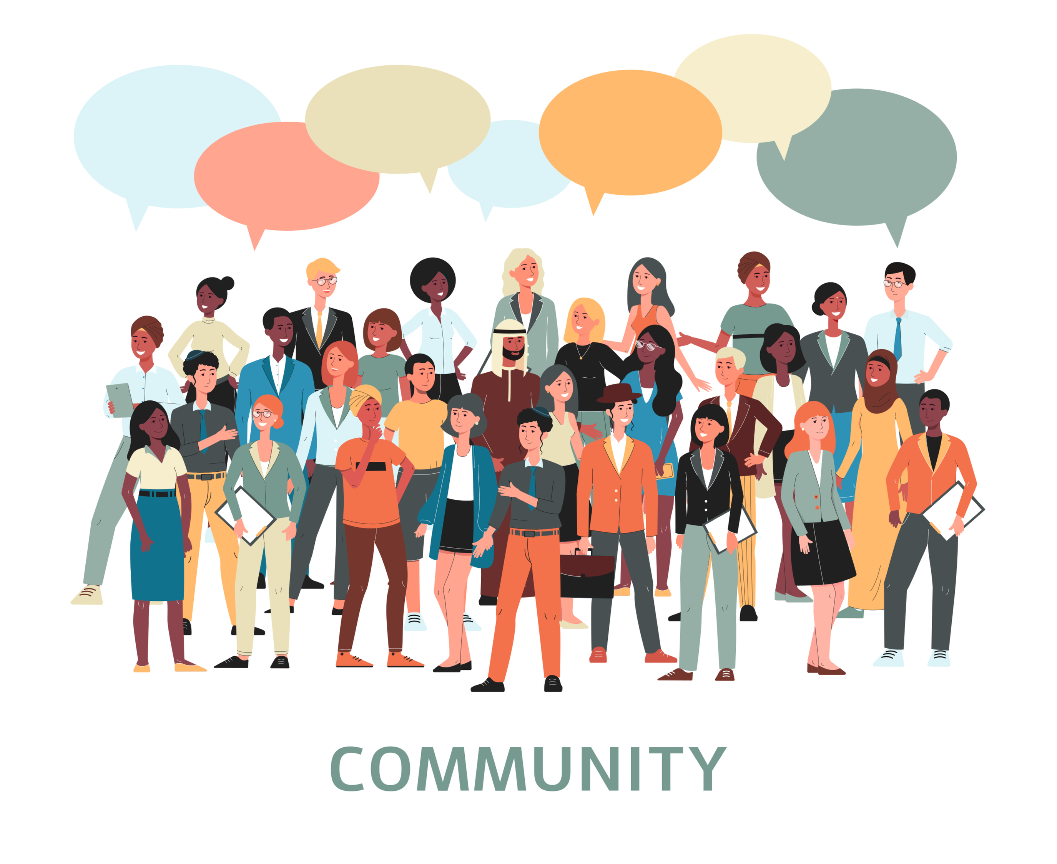
in social media
🏳️‍🌈
👇🏼
🔴
🤦🏽‍♀️
✝️
😂
❤️
🗳
🌊
and what it reveals about us.

Slide 27
Main social science theory
Symbolic Interactionism
Interactions shape our social identity
They enable us to interpret the meaning of non-verbal cues and signs during interactions
Gives meaning to shared symbols and behaviors which define a social group or society
Blumer, H. (1962). Society as symbolic interaction.

Slide 28
Main social science theory
Symbolic Interactionism
Interactions shape our social identity
They enable us to interpret the meaning of non-verbal cues and signs during interactions
Gives meaning to shared symbols and behaviors which define a social group or society
🤝 🤗 🙏 🤷‍♀️
Blumer, H. (1962). Society as symbolic interaction.

Slide 29
Main social science theory
Symbolic Interactionism
Interactions shape our social identity
They enable us to interpret the meaning of non-verbal cues and signs during interactions
Gives meaning to shared symbols and behaviors which define a social group or society
🤝 🤗 🙏 🤷‍♀️
🇺🇸 ▶️ 🎄🍑
Blumer, H. (1962). Society as symbolic interaction.

Slide 30
Research questions
RQ1: What are the differences in emoji use across users and documents in social media?
RQ2: In what way do emojis reveal cues about social identity and individual communication style preferences?
RQ3: What are the collective patterns and behaviors that arise from individual emoji use and what do they reveal about social norms?

Slide 31
Research questions
RQ1: What are the differences in emoji use across users and documents in social media?
RQ2: In what way do emojis reveal cues about social identity and individual communication style preferences?
RQ3: What are the collective patterns and behaviors that arise from individual emoji use and what do they reveal about social norms?
Symbolic representations of identity
Collective behavior of emoji use

Slide 32
Datasets
Twitter as a representative example of social media.
Elections:
44M tweets for 2018 U.S. midterm elections keywords, candidates
Events:
33M tweets Jan-March 2019 across 71 events
6M emoji tweets related to 2019 lunar eclipse
Place:
2M emoji geo-tagged tweets for Wash. DC, 2014-2017

Slide 33
Research objectives and methods

Slide 34
Research objectives and methods
📊
formation of a baseline of emoji use in a social media data
develop a framework to enable comparison of emoji use and structure in documents
identify communication patterns and emojis related to particular events and types of places
identify and describe emoji use relating to individual or collective identities
🔺
👍🏽
📕
📆 🌍
👯‍♀️

Slide 35
RO 1: Baseline
📊
formation of a baseline of emoji use in a social media data
develop a framework to enable comparison of emoji use and structure in documents
identify communication patterns and emojis related to particular events and types of places
identify and describe emoji use relating to individual or collective identities

Slide 36
RO 1: Baseline
📊
formation of a baseline of emoji use in a social media data
develop a framework to enable comparison of emoji use and structure in documents
identify communication patterns and emojis related to particular events and types of places
identify and describe emoji use relating to individual or collective identities
Emoji use prevalence in dataset and across users
💬
Doesn’t everyone use emojis?
🔺
👍🏽
📕
📆 🌍
💁🏻‍♀️
👯‍♀️

Slide 37
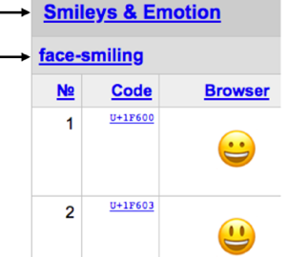
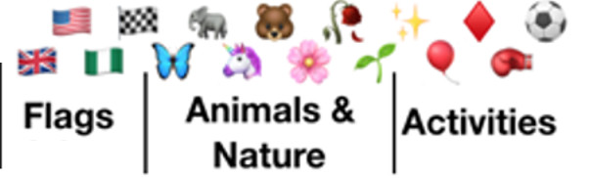
RO 1: Baseline
📊
formation of a baseline of emoji use in a social media data
develop a framework to enable comparison of emoji use and structure in documents
identify communication patterns and emojis related to particular events and types of places
identify and describe emoji use relating to individual or collective identities
Emoji use prevalence in dataset and across users
Which emojis are used
💬
Doesn’t everyone use emojis?
🔺
👍🏽
📕
📆 🌍
💁🏻‍♀️
Group
Sub-group
👯‍♀️
Unicode

Slide 38
RO 2: Comparison
📊
formation of a baseline of emoji use in a social media data
develop a framework to enable comparison of emoji use and structure in documents
identify communication patterns and emojis related to particular events and types of places
identify and describe emoji use relating to individual or collective identities
🔺
👍🏽
📕
📆 🌍
👯‍♀️

Slide 39
RO 2: Comparison
📊
formation of a baseline of emoji use in a social media data
develop a framework to enable comparison of emoji use and structure in documents
identify communication patterns and emojis related to particular events and types of places
identify and describe emoji use relating to individual or collective identities
🔺
👍🏽
📕
Compare these emojis.

Slide 40
RO 2: Comparison
📊
formation of a baseline of emoji use in a social media data
develop a framework to enable comparison of emoji use and structure in documents
identify communication patterns and emojis related to particular events and types of places
identify and describe emoji use relating to individual or collective identities
🔺
👍🏽
📕
Object or book
Symbol or shape
Hand
(anthropomorphic)

Slide 41
RO 2: Comparison
📊
formation of a baseline of emoji use in a social media data
develop a framework to enable comparison of emoji use and structure in documents
identify communication patterns and emojis related to particular events and types of places
identify and describe emoji use relating to individual or collective identities
Direction: Pointing Up
🔺
👍🏽
📕
Object or book
Symbol or shape
Hand
(anthropomorphic)
Color: Red

Slide 42

RO 2: Comparison
📊
formation of a baseline of emoji use in a social media data
develop a framework to enable comparison of emoji use and structure in documents
identify communication patterns and emojis related to particular events and types of places
identify and describe emoji use relating to individual or collective identities
Source: Unicode emoji charts
💻
👀
❌
✅

Slide 43
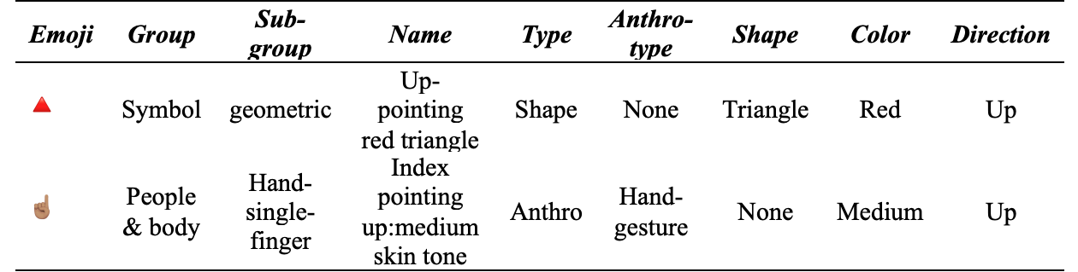

RO 2: Comparison
📊
formation of a baseline of emoji use in a social media data
develop a framework to enable comparison of emoji use and structure in documents
identify communication patterns and emojis related to particular events and types of places
identify and describe emoji use relating to individual or collective identities
ATTRIBUTES:
🔺
Unicode
Unicode
Unicode
----Custom----
-----from the name-----

Slide 44
RO 2: Comparison
📊
formation of a baseline of emoji use in a social media data
develop a framework to enable comparison of emoji use and structure in documents
identify communication patterns and emojis related to particular events and types of places
identify and describe emoji use relating to individual or collective identities
ATTRIBUTES:
🔺
Unicode
----Custom----
-----from the name-----
Group
Sub-group
Unicode

Slide 45
RO 3: Identify events and places
📊
formation of a baseline of emoji use in a social media data
develop a framework to enable comparison of emoji use and structure in documents
identify communication patterns and emojis related to particular events and types of places
identify and describe emoji use relating to individual or collective identities
🔺
👍🏽
📕
📆 🌍
👯‍♀️

Slide 46

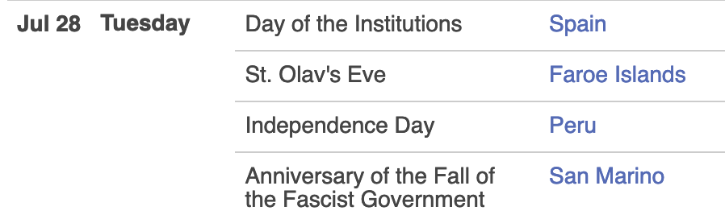
RO 3: Identify events and places
📊
formation of a baseline of emoji use in a social media data
develop a framework to enable comparison of emoji use and structure in documents
identify communication patterns and emojis related to particular events and types of places
identify and describe emoji use relating to individual or collective identities
📆
📰
🌍
🔺
👍🏽
📕
🗺
👯‍♀️
www.timeanddate.com

Slide 47
RO 4: Describe emoji use in a document
📊
formation of a baseline of emoji use in a social media data
develop a framework to enable comparison of emoji use and structure in documents
identify communication patterns and emojis related to particular events and types of places
identify and describe emoji use relating to individual or collective identities
🔺
👍🏽
📕
📆 🌍
👯‍♀️

Slide 48
RO 4: Describe emoji use in a document
Structural analysis (or description)
of emoji use in a document
📊
formation of a baseline of emoji use in a social media data
develop a framework to enable comparison of emoji use and structure in documents
identify communication patterns and emojis related to particular events and types of places
identify and describe emoji use relating to individual or collective identities
Structural content analysis
Type and order of content in a document
eVAPOR
emoji:
Attributes
Position
Order
Repetition
🔺
👍🏽
📕
📆 🌍
👯‍♀️

Slide 49
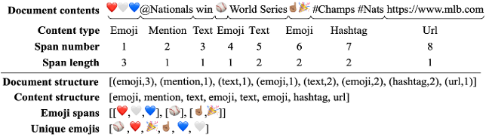
Structural content analysis

Slide 50
Structure of emoji use (eVAPOR)
emoji
Vector of:
Attributes
Position with document
Order of emojis or attributes
Repetition of emojis or attributes
(Group, Subgroup, Name, Type, Shape, Color, Direction)
(First, Beginning, Middle, End, Last)
(“red, white, blue”, emoji reversal)
(Redundant, Emphasis, Amplification)

Slide 51
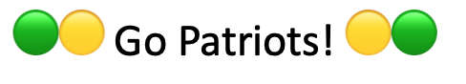
Structural of emoji use (eVAPOR)
eVAPOR for: 🟢🟡 Go Patriots! 🟡🟢
[{Attributes:
{💚: [Smileys&Emotion, Emotion, green heart, shape, none, heart, green, none],
💛: [Smileys&Emotion, Emotion, yellow heart, shape, none, heart, yellow, none]},
Position: [First, Last],
Order: {color:[(green, yellow),(yellow, green)],
reversal: True},
Repetition: {Emphasis: True,
Amplification: {color: [green, yellow]}}
}]
Group, Subgroup, Name, Type, Anthro, Shape, Color, Direction

Slide 52
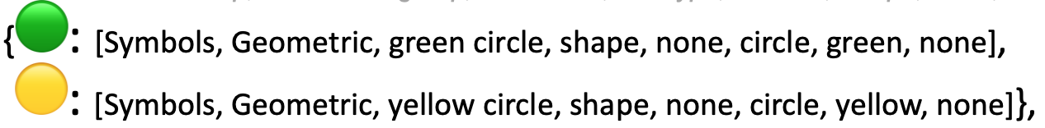
Structural analysis of emoji use
eVAPOR for: 🟢🟡 Go Patriots! 🟡🟢
[{Attributes:
{🟢: [Symbols, Geometric, green circle, shape, none, circle, green, none],
🟡: [Symbols, Geometric, yellow circle, shape, none, circle, yellow, none]},
Position: [First, Last],
Order: {color:[(green, yellow),(yellow, green)],
reversal: True},
Repetition: {Emphasis: True,
Amplification: {color: [green, yellow]}}
}]
Group, Subgroup, Name, Type, Anthro, Shape, Color, Direction

Slide 53
Structural analysis of emoji use
eVAPOR for: 🟢🟡 Go Patriots! 🟡🟢
[{Attributes:
{🟢: [Symbols, Geometric, green circle, shape, none, circle, green, none],
🟡: [Symbols, Geometric, yellow circle, shape, none, circle, yellow, none]},
Position: [First, Last],
Order: {color:[(green, yellow),(yellow, green)],
reversal: True},
Repetition: {Emphasis: True,
Amplification: {color: [green, yellow]}}
}]
Group, Subgroup, Name, Type, Anthro, Shape, Color, Direction

Slide 54
Research questions
RQ1: What are the differences in emoji use across users and documents in social media?
RQ2: In what way do emojis reveal cues about social identity and individual communication style preferences?
RQ3: What are the collective patterns and behaviors that arise from individual emoji use and what do they reveal about social norms?
Notes:
RQ1: What are the differences in emoji use across users and documents in social media?
RQ2: In what way do emojis reveal cues about social identity and individual communication style preferences?
RQ3: What are the collective patterns and behaviors that arise from individual emoji use and what do they reveal about social norms?
I all address these in greater detail in a little bit.

Slide 55
RQ 1: Baseline emoji use, and documents
What are the differences in emoji use across users and documents in social media?
🏳️‍🌈
👇🏼
🔴
🤦🏽‍♀️
✝️
😂
❤️
🗳
🌊

Slide 56
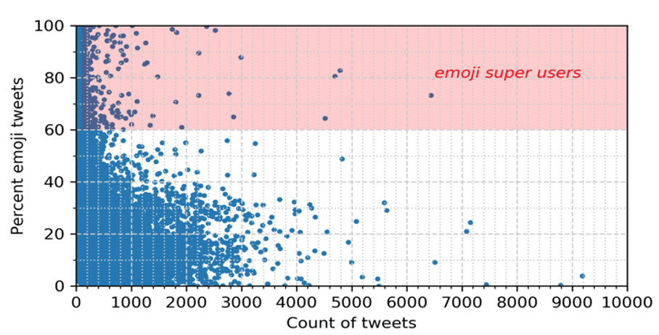
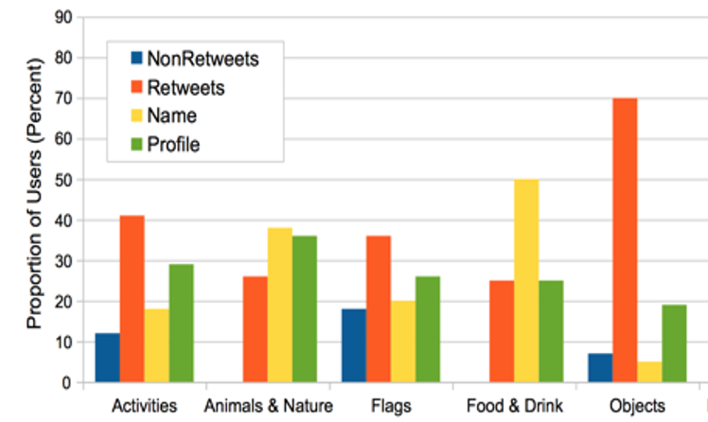
RQ 1: Baseline emoji use, and documents
Not many emoji tweets and users, but there are emoji super users
Differences in emoji use by document type
Most used emojis serve as baseline emojis for comparison
😂 😩 😍 💯😘 😒 😭 😊 🙌❤️

Slide 57
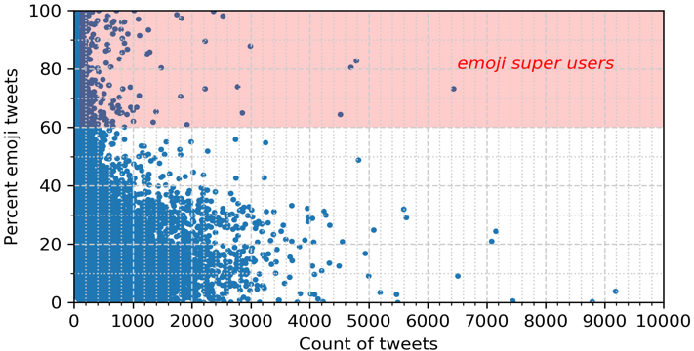
RQ 1: User baseline trends of behavior
Main findings:
Most emoji users had 1-4 emojis in a tweet
Across their tweets, emojis mainly came from the same few groups
Emoji super users: used more emojis, more variety, and had a higher percent of
Data associated with 2018 U.S. midterm election tweets
Swartz, M., & Crooks, A. (2020). Comparison of Emoji Use in Names, Profiles, and Tweets. In 2020 IEEE 14th International Conference on Semantic Computing (ICSC ‘20) (pp. 375-380). IEEE.

Slide 58
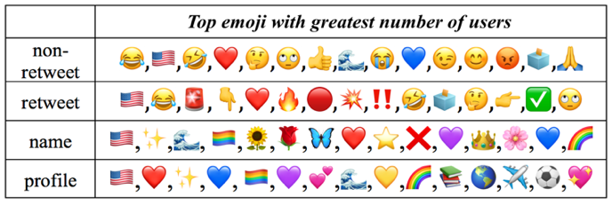
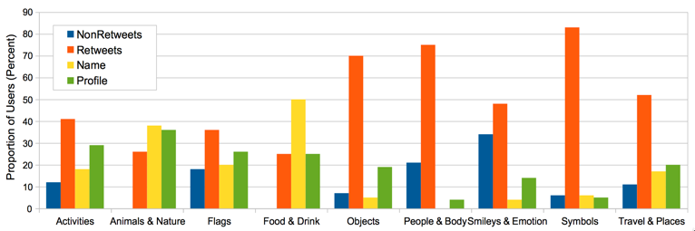
RQ 1: Difference by document type
Main findings:
Non-retweets (blue) smileys
Retweets (orange) symbols
Names (yellow) decoration
Profiles (green) descriptive
Data associated with 2018 U.S. midterm election tweets and user profiles

Slide 59
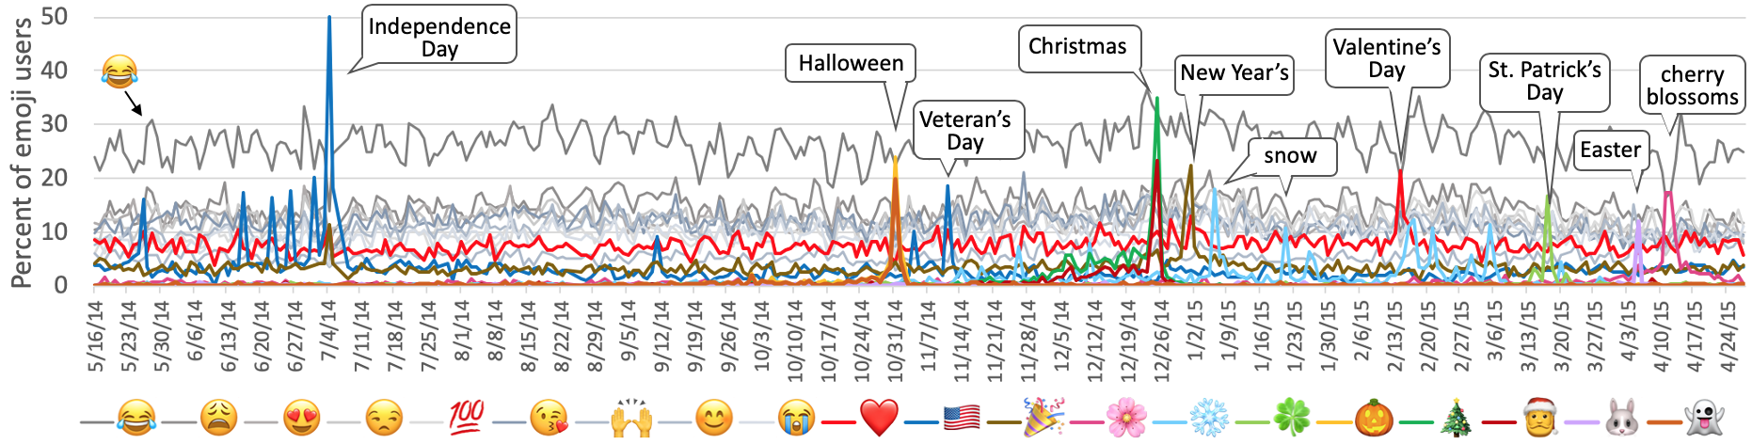
RQ 1: Baseline emojis
Main findings:
Similar to emojitracker results, same few emojis used by most users across tweets, collections
Use them as a baseline for trends 😂 😩 😍 💯😘 😒 😭 😊 🙌❤️
Top emojis used in geolocated tweets in Washington DC 2014-2015

Slide 60
RQ 2: Identity and communication
In what way do emojis reveal cues about social identity and individual communication style preferences?
Notes:
RO2: inspired by Pennebaker theory on linguistic style as a fingerprint, and research by Pfoser’s students on fingerprinting, need a way to analyze and represent emoji use in a document, and measure behavior of emoji use such as consistency of emojis used and the way they are used (addressed in Chapter 4 and 5 and associated with RQ: 2 and 3)

Slide 61
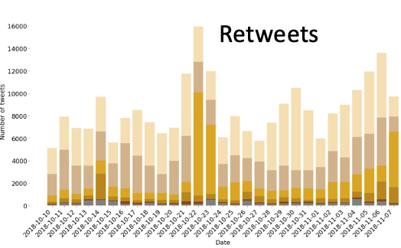
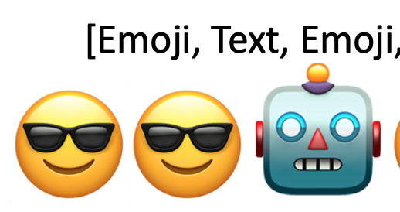
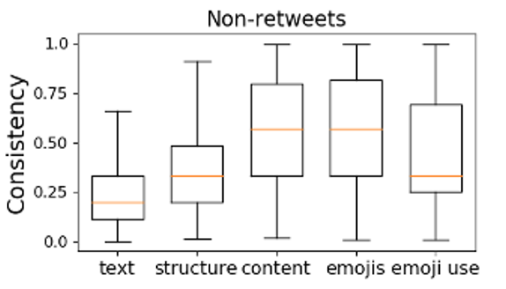
RQ 2: Identity and communication
Draws from social science theory on identity (Goffman) and communication/linguistics (Giles; Pennebaker)
Explored identity based on diversity attributes
Skintone, Gender, Religion, Political Ideology
Used structural content analysis and eVAPOR to identify communication styles of emoji use
Developed measured of consistency for user behavior

Slide 62
RQ 2: Social science theories
Online identity on social media is a balance of true self and represented self
Self-Identity and Presentation of Self
Goffman, 1990
Individual communication styles and preferences
Linguistic style accommodation
Linguistic styles of groups from interactions
Social norms and behaviors shape individual linguistic patterns
Linguistic Communication Styles and Patterns
(Levelt & Kelter, 1982; Pennebaker et al., 2003; Giles, 1973)

Slide 63
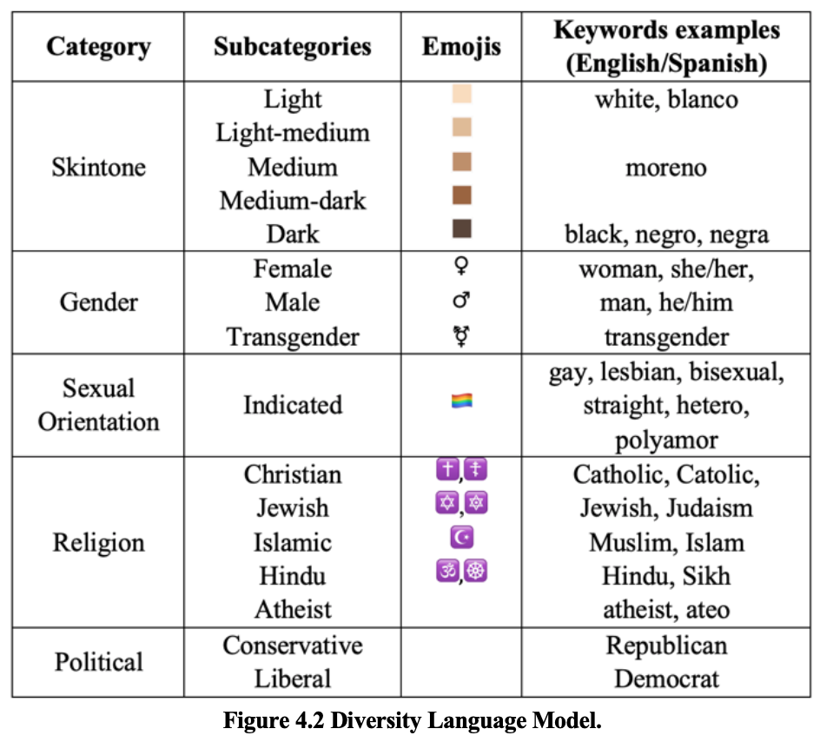
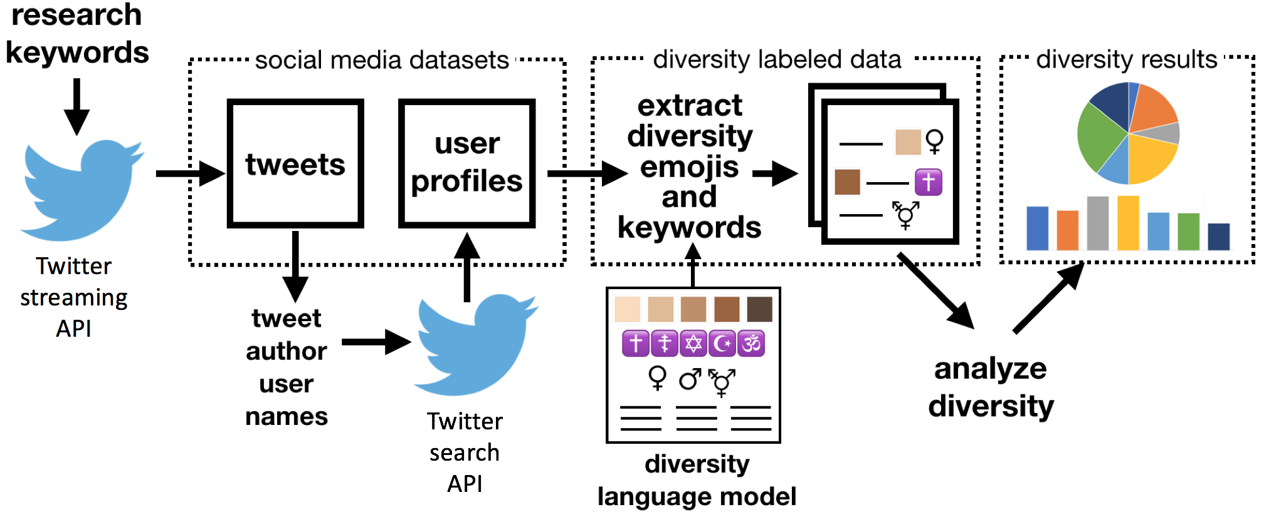
RQ 2: Diversity model
Swartz, M., Crooks, A., & Kennedy, W. (2020). Diversity from Emojis and Keywords in Social Media. In International Conference on Social Media and Society (pp. 92-100).

Slide 64
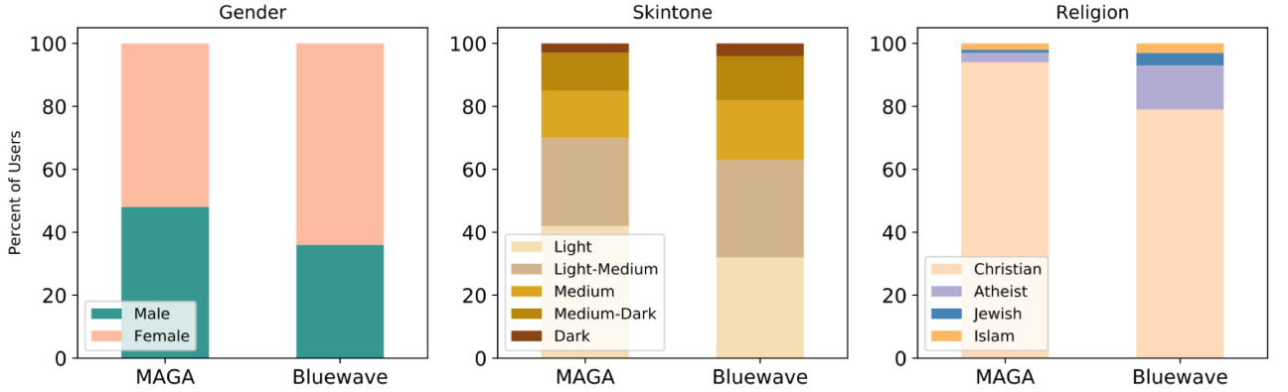
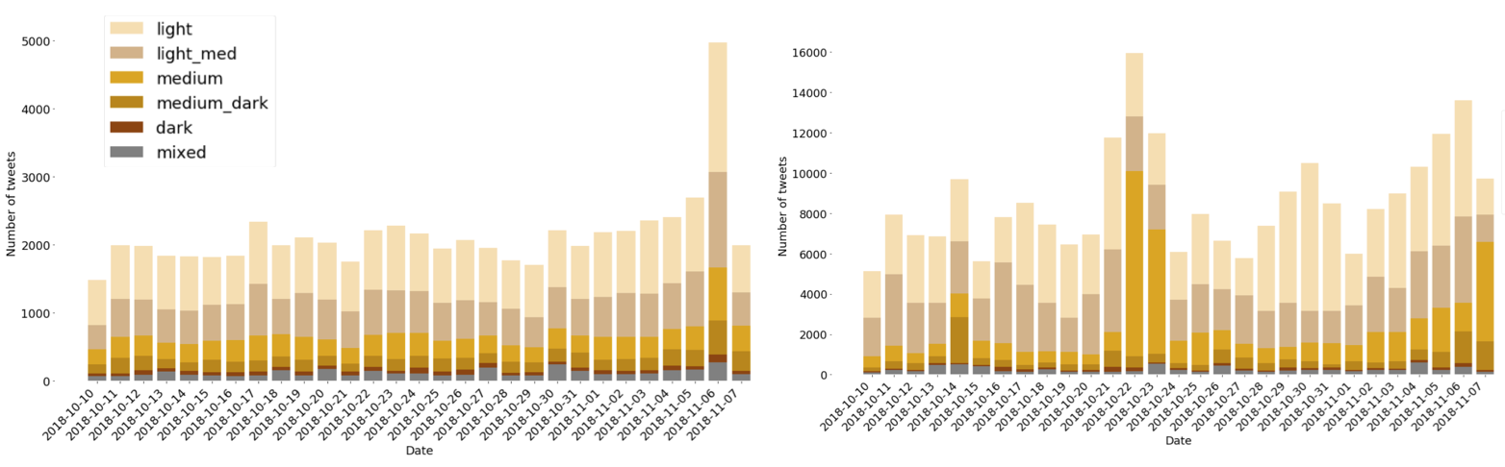
RQ 2: Diversity analysis
Main findings:
Identify political ideology based on campaign slogans
Use profile descriptions rather than aggregating
Diversity analysis revealed patterns not easily seen
Diversity analysis provided first glance of diversity compositions of social media sample
Non-retweets
Retweets
Temporal analysis of tweets by skintone
Data associated with 2018 U.S. midterm election tweets and user profiles

Slide 65
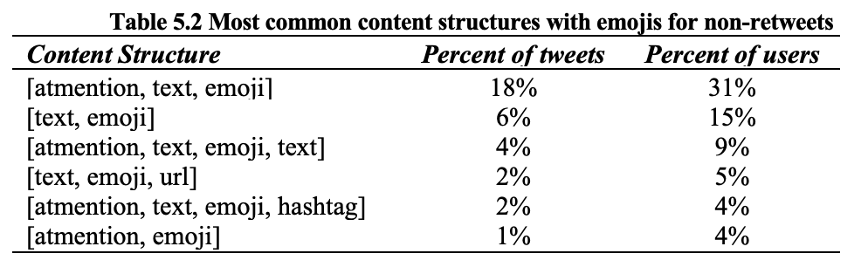
RQ 2: Communication structures
Main findings:
Few common structures of tweets
Structure of content and emoji use not unique but not often copied
Can find similar accounts based on similar style of emoji use
Data associated with 2018 U.S. midterm election tweets
[Emoji, Text, Emoji, Mention, Emoji, Url, Emoji, Text]
😎😎🤖😎😎😎

Slide 66
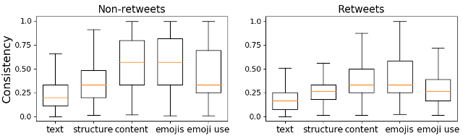
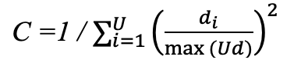
RQ 2: Consistency of behavior
Main findings:
Possible to measure behavior for consistency of style of emoji use and content
Users more consistent with content structure and unique emojis
More consistency in non-retweets
Measure of Consistency:
Data associated with 2018 U.S. midterm election tweets and user profiles

Slide 67
RQ 3: Collective behavior and emoji use
What are the collective patterns and behaviors that arise from individual emoji use and what do they reveal about social norms?

Slide 68
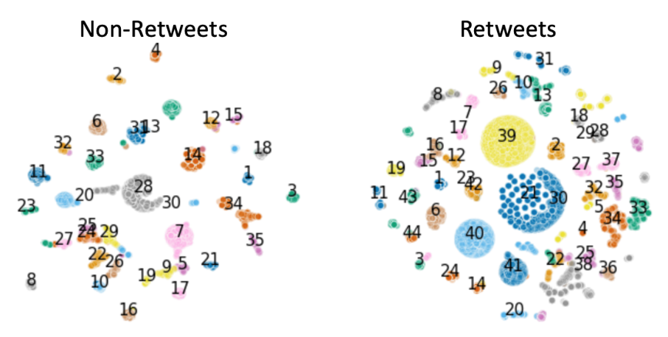
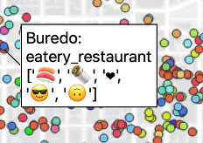
RQ 3: Collective behavior and emoji use
Draws from social science theory on social identity, events and place identity
Similar behavior for consistency user role
Shared identity through symbolism during events
Shared experience at place
🌹
✊
🇱🇹

Slide 69
RQ 3: Social science theories
Role of Symbols and Events on Society and Culture
Role of Symbols and Events on Society and Culture
Acknowledgement of values and beliefs
Solidarity and collective identity
Use of symbolism and rituals
Place-identity
Laing & Frost, 2015; Edensor, 2002; Wilson, 1954

Slide 70
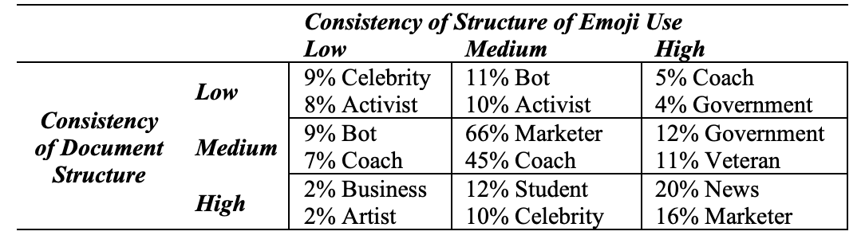
RQ 3: Similar behavior for user role
Main findings:
Clustering users based on consistency score yielded distinct groups with similar behavior
High consistency of emoji structure may mean auto generated account, but not all bots are bad
User roles from profile description
Data associated with 2018 U.S. midterm election tweets and user profiles

Slide 71
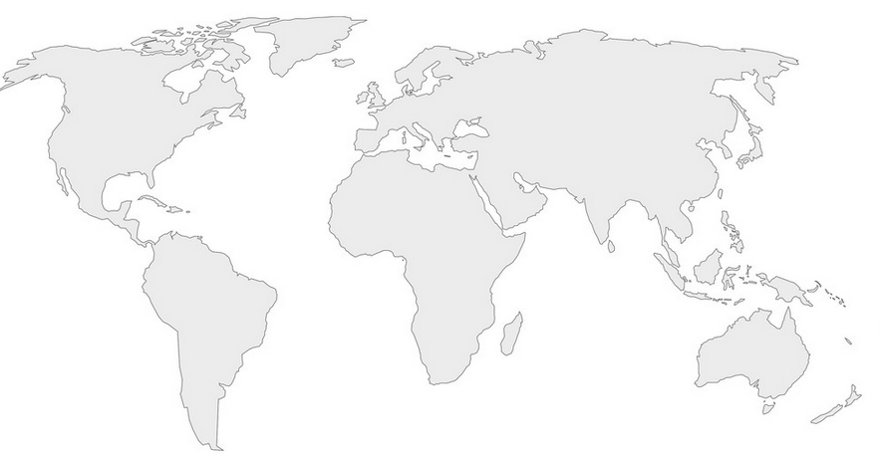
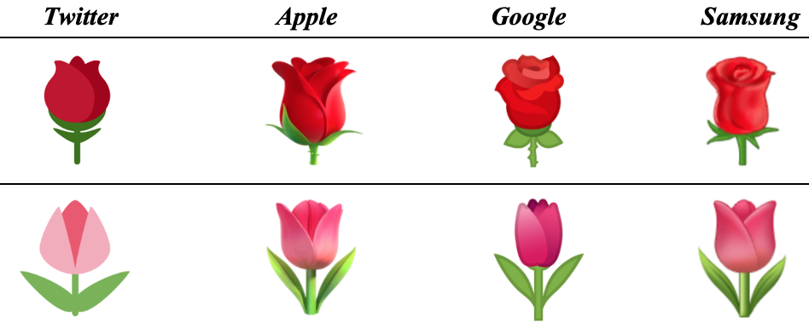
RQ 3: Shared identity and symbols
International Women’s Day 2019 regional emoji use
Main findings:
Emoji use as symbolism and icons
Regional/cultural variations in emoji use during shared event
Appearance of emoji may impact use or substitution with other emoji
Supposed to be a red tulip?
💪
💪
🌹
💐
❤️
red rose
tulip

Slide 72
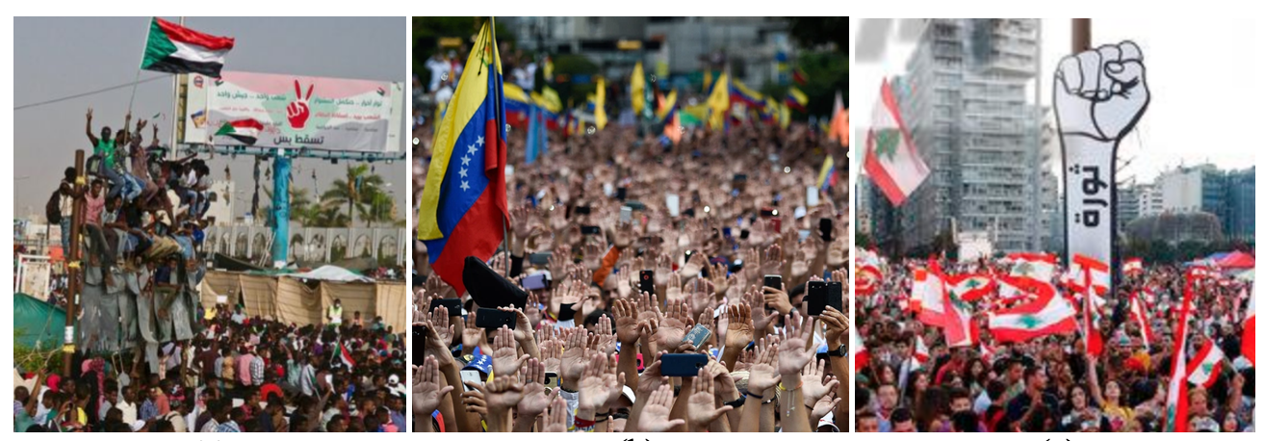
RQ 3: Shared identity and symbols
Main findings:
Emoji use as shared identity and solidarity during protests
(Leithead, 2019)
(Parra, 2019)
(Hussein , 2019)
✌️
✋
✊

Slide 73
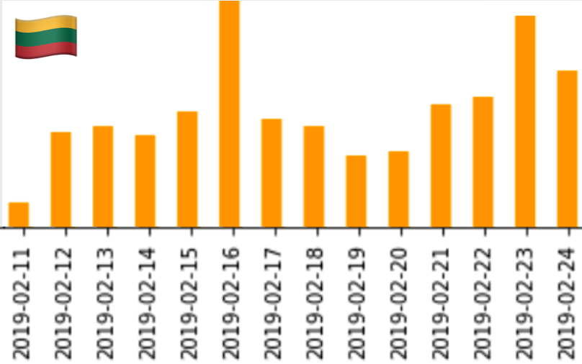
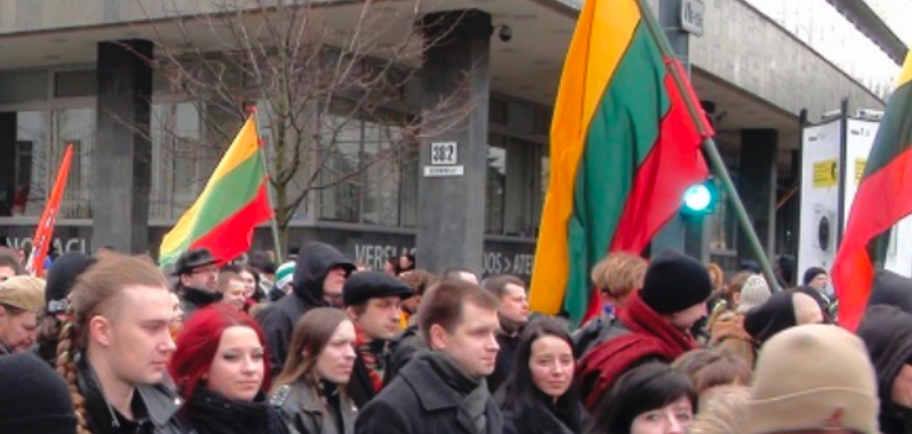

RQ 3: Shared identity and symbols
Main findings:
National flag colors of emojis to indicate national identity or support
National holiday
Eurovision
Images: People marching in Vilnius for the national holiday of Lithuania’s http://www.truelithuania.com/topics/culture-of-lithuania/holidays-celebrations, Tweets on the day of Lithuania’s Statehood Day Feb 16.

Slide 74


RQ 3: Shared experience and type of place
Main findings:
Emoji use as interaction with place based on description of function of place with icon emojis
Collective emoji use reveals local events such as weather, cherry blossoms
Emoji model of place
Washington DC 2015-2017 POI tagged emoji tweets

Slide 75
Dissertation conclusions
My research demonstrates:
Emojis are much more than face gestures, sentiment, sarcasm
Emojis provide different information than words
Can derive symbolic representations of identity cues from emojis
Despite individual preferences in emoji use, common behavior styles and emerge
From these shared styles and behavior of emoji use can derive cues of symbolic representations of collective behavior

Slide 76
Limitations and areas for future work
Limitations of this research:
Further work:
Other social media platforms
Does not fully explain why we use emojis this way
Combine traditional methods of research (surveys)
Snapshots in time and place
Longitudinal studies, more time, more space, more topics, more emojis

Slide 77

How this fits in CSS
Multidisciplinary
Social Science theories
Identity
Symbolic interactionism
Communication studies
Socio-linguistics
Linguistic Accommodation
Computation
Computation and methods
NLP, machine learning, geo, temporal, SNA

Slide 78
Research contributions
First study to examine patterns of behavior of emoji use
Link theory and computational methods
Enables comparison of emoji use by using attributes and eVAPOR
New methods
Methods developed as part of this research are applicable to analysis of emoji use in any document
Consistency metric
Structural content analysis
Structure of emoji use (eVAPOR)
Publications from dissertation

Slide 79
Research publications
Peer-reviewed conference papers from dissertation (so far):
Chapter 3: Swartz, M., & Crooks, A. (2020, February). Comparison of Emoji Use in Names, Profiles, and Tweets. In 2020 IEEE 14th International Conference on Semantic Computing (ICSC ‘20) (pp. 375-380). IEEE.
Chapter 4: Swartz, M., Crooks, A., & Kennedy, W. (2020, July). Diversity from Emojis and Keywords in Social Media. In International Conference on Social Media and Society (pp. 92-100).
Chapter 5: Swartz, M., Crooks, A., & Croitoru, A. (2020, October). Beyond Words: Comparing Structure, Emoji Use, and Consistency Across Social Media Posts. In 2020 International Conference on Social Computing, Behavioral-Cultural Modeling and Prediction and Behavior Representation in Modeling and Simulation (SBP-BRIMS ‘20). Springer.
Other peer-reviewed papers:
Al-Khulaidy, A., & Swartz, M. (2020, May). Along the border: an agent-based model of migration along the United States-Mexico border. In IEEE Proceedings of the 2020 Spring Simulation Conference (pp. 1-12).
Malik, A.A., Crooks, A.T., Root, H.L. and Swartz, M. (2015), Exploring Creativity and Urban Development through Agent-Based Modeling, Journal of Artificial Societies and Social Simulation. 18 (2): 12. Available at http://jasss.soc.surrey.ac.uk/18/2/12.html.

Slide 80

Code and methodologies on Github
Code available: https://github.com/msemoji
Notes:
The code I have developed for this dissertation will be available on github in order to support reproducibility and to help other social media researchers gain insights from the emojis in their datasets.

Slide 81

Thank you for listening.
Any questions or comments?
Source: Clip from South Park episode S20e06, Comedy Central.
Notes:
Thank you for your time. Now I would like to open it up for any questions and feedback.

